Slide 1






Enhanced environmental protection inspection for efficient control of air quality monitoring and of all entities under obligation within system of greenhouse gas emission allowance trading, in order to achieve better quality of air in Republic of Croatia
This project is funded by the European Union

Slide 2



TOPIC 10: Implementation of EU and Croatia’s regulations
Energy research and Environmental Protection Institute

Slide 3

10.1 REGULATIONS OF THE REPUBLIC OF CROATIA
European Union IPA 2013 Programme for Croatia
Regulations of the Republic of Croatia from the field of air quality in the Republic of Croatia
Air Protection Act (Official Gazette 130/11, 47/14, 61/17)
Ordinance on the Air Quality Monitoring (Official Gazette 79/17)
Ordinance on mutual information exchange and reporting on air quality and obligations for implementation of Commission’s Decision 2011/850 / EU (Official Gazette 3/16)
Regulation on the level of pollutants in the air (Official Gazette 117/12, 84/17)
Regulation on the Determination of Areas and Agglomerations by Levels of Air Pollution on the Territory of the Republic of Croatia (Official Gazette 1/14)
Regulation on the establishment of a list of measurement points for concentration monitoring of certain pollutants in the air and the location of monitoring stations in the national network for the continuous air quality monitoring (Official Gazette 65/16)
Monitoring Program for Air Pollution in the national network for permanent air quality monitoring (Official Gazette 73/16)
Institut za energetiku i zaštitu okoliša
Energy Research and Environmental Protection Institute

Slide 4
10.1 REGULATIONS OF THE REPUBLIC OF CROATIA
European Union IPA 2013 Programme for Croatia
Air Protection Act (official gazette 130/11, 47/14, 61/17)
Air protection area in the Republic of Croatia and the area of air quality monitoring are regulated by the "Air Protection Act" and secondary regulations that are in line with the EU regulations and the international agreements signed by the Republic of Croatia.
The Air Protection Act is the highest regulatory act in the field of air protection, and it contains three acts passed in 2011 ("Air Protection Act" NN 130/11), 2014 („Law on Amendments to Air Protection Act" NN 47/14) and 2017 ("Law on Amendments to Air Protection Act" NN 61/17).
The constitutional basis for the adoption of the Air Protection Act is contained in Article 2, paragraph 4 of the Constitution of the Republic of Croatia.
All regulations can be found on the Ministry’s website at the following link
http://www.mzoip.hr/hr/okolis/propisi-i-medunarodni-ugovorixxxxx.html
Institut za energetiku i zaštitu okoliša
Energy Research and Environmental Protection Institute

Slide 5
10.1 REGULATIONS OF THE REPUBLIC OF CROATIA
European Union IPA 2013 Programme for Croatia
Air Protection Act (OG 130/2011)
The Air Protection Act (OG 130/2011) entered into force on 24 November 2011. It is in line with the provisions of the EU Directives so that it is by its very nature a framework law in accordance with Directive 2008/50 / EC of the European Parliament and of the Council on ambient air quality and cleaner air for Europe, which regulates air quality management and assessment.With the accession of the Republic of Croatia to the European Union, the Act on Amendments to the Air Protection Act (OG 47/14) was adopted in order to ensure direct implementation of other regulations and decisions of the European Union in the field of air protection and industrial pollution. The competent bodies and tasks of the competent authorities bodies were determined, as well as administrative and inspection supervision and penalties for the implementation of EU acts were prescribed. In the period since the adoption of the Act on Amendments to the Environmental Protection Act (OG 47/14), the European Union adopted in the field of air quality Directive 2015/1480 (on 28th August 2015) amending certain annexes to Directives 2004/107 / EC and 2008/50 / EC on the establishment of rules for reference methods, validation of data and location of sampling points for air quality assessment.
Energy Research and Environmental Protection Institute
Institut za energetiku i zaštitu okoliša

Slide 6
10.1 REGULATIONS OF THE REPUBLIC OF CROATIA
European Union IPA 2013 Programme for Croatia
Air Protection Act (OG 130/2011, 47/14, 61/17) establishes following:
fundamental goals of air protection,
meaning of terms in the sense of the Act,
institutional jurisdiction and responsibility for the implementation of the Act are established,
systematic documents and participation of the public in development thereof;
the way of monitoring and assessing air quality on the territory of the Republic of Croatia,
classification of the territory of the State into zones and agglomerations with respect to air pollution levels,
measures to prevent and reduce air pollution,
adopting action plans to improve air quality,
reporting on air quality and data exchange,
conducting professional tasks of air quality monitoring and air emissions,
Institut za energetiku i zaštitu okoliša
Energy Research and Environmental Protection Institute

Slide 7
10.1 REGULATIONS OF THE REPUBLIC OF CROATIA
European Union IPA 2013 Programme for Croatia
Air Protection Act (OG 130/11, 47/14, 61/17) establishes following (continued):
substances that damage the ozone layer and fluorinated greenhouse gases,
monitoring of greenhouse gas emissions and measures to mitigate and adapt to climate change,
Air protection information system,
financing air protection, ozone layer, mitigation of climate change and adaptation to climate change
economic incentives,
administrative and inspection supervision,
violations and fines
and transitional and final provisions which, inter alia, determine the deadlines for the implementation of certain provisions of the Act.
Institut za energetiku i zaštitu okoliša
Energy Research and Environmental Protection Institute

Slide 8
10.1 REGULATIONS OF THE REPUBLIC OF CROATIA
European Union IPA 2013 Programme for Croatia
Text of the Act is divided into 14 chapters :
GENERAL PROVISIONS
PLAN, PROGRAMS AND REPORTS
AIR QUALITY MONITORING AND ASSESSMENT
MEASURES FOR PREVENTING AND REDUCING AIR POLLUTION
REPORTING ON AIR QUALITY AND DATA EXCHANGE
ACTIVITIY OF AIR QUALITY AND AIR EMISSION MONITORING
SUBSTANCES HARMFUL TO THE OZONE LAYER AND FLUORINATED GREENHOUSE GASES
MONITORING GREENHOUSE GAS EMISSIONS AND MITIGATION MEASURES FOR CLIMATE CHANGE ADAPTATION
AIR PROTECTION INFORMATION SYSTEM
FINANCING AIR AND OZONE LAYER PROTECTION, MITIGATION OF CLIMATE CHANGE AND CLIMATE CHANGE ADAPTATION
ECONOMIC INCENTIVES
ADMINISTRATIVE SUPERVISION
INSPECTION SUPERVISION
PENALTIES
Institut za energetiku i zaštitu okoliša
Energy Research and Environmental Protection Institute

Slide 9
10.1 REGULATIONS OF THE REPUBLIC OF CROATIA
European Union IPA 2013 Programme for Croatia
Ordinance on the Air Quality Monitoring (OG 79/17)
It was passed on basis of Article 52 of Air Protection Act(official gazette»Narodne novine«, no. 130/11, 47/14 i 61/17)
The Ordinance contains provisions in line with EU Directives: Directive 2008/50/EZ, Directive 2004/107/EZ and EU Commission Directive 2015/1480 on amendment of certain annexes to directives 2004/107/EZ and 2008/50/EZ
Ordinance stipulates through 6 chapters and 9 annexes following:
Method of monitoring air quality and data collection,
Standards for measurement point locations,
Standards for determining the minimum number of measurement points,
Reference measurement methods,
Method of proving equivalence for other measurement methods
Institut za energetiku i zaštitu okoliša
Energy Research and Environmental Protection Institute

Slide 10
10.1 REGULATIONS OF THE REPUBLIC OF CROATIA
European Union IPA 2013 Programme for Croatia
Ordinance on the Air Quality Monitoring (Official Gazette 79/17) stipulates through its 6 chapters and 9 annexes following (continued):
Method of measuring the measurement and data quality,
Method of processing and presentation of results and compliance with Croatian standards,
Method of checking precision and calibration of measuring instruments,
Method and cost of reference laboratories operation,
Establishment and method of work of the committee for monitoring the work of reference laboratories,
Method of delivering data for the purpose of the information system of air protection,
Annual report content and
Method of regular information of the public.
Institut za energetiku i zaštitu okoliša
Energy Research and Environmental Protection Institute

Slide 11
10.1 REGULATIONS OF THE REPUBLIC OF CROATIA
European Union IPA 2013 Programme for Croatia
Ordinance on mutual information exchange and reporting on air quality and obligations for implementation of Commission’s Decision
2011/850/EU (OG 3/16)
It was adopted pursuant to Article 120, paragraph 3 of the Air Protection Act (Official Gazette 130/11 and 47/14).
The Ordinance transposes Directive 2008/50 / EC into the legal order of the Republic of Croatia and establishes the competent authority and framework for the implementation of the Commission’s Implementing Decision on mutual information exchange and reporting on air quality (2011/850 / EU).
The Ordinance outlines the tasks of the Croatian Agency for the Environment and Nature and other bodies related to the manner, deadlines, content and format of the data and the method of data collection for mutual exchange of information and reporting on the assessment and management of air quality.
Institut za energetiku i zaštitu okoliša
Energy Research and Environmental Protection Institute

Slide 12
10.1 REGULATIONS OF THE REPUBLIC OF CROATIA
European Union IPA 2013 Programme for Croatia
Ordinance on mutual information exchange and reporting on air quality and obligations for implementation of Commission’s Decision
2011/850/EU (OG 3/16) stipulates:
Agency as the Competent Authority for the Implementation of Commission’s Decision 2011/850 / EU
For the purpose of Decision implementation 2011/850 / EU of the Commission, the Agency delivers the information used for the mutual exchange of information and reporting on behalf of the Republic of Croatia into the data repository established by the European Commission with the assistance of the European Environment Agency within the prescribed deadlines;
In case of updating the information, the Agency explains the differences between updated and original information and the reasons for updating and publishes the European Commission's Guidelines for Mutual Information Exchange and Air Quality Reporting on its website.
The attached Ordinance prescribes the mandatory content of action plans to improve air quality
Institut za energetiku i zaštitu okoliša
Energy Research and Environmental Protection Institute

Slide 13
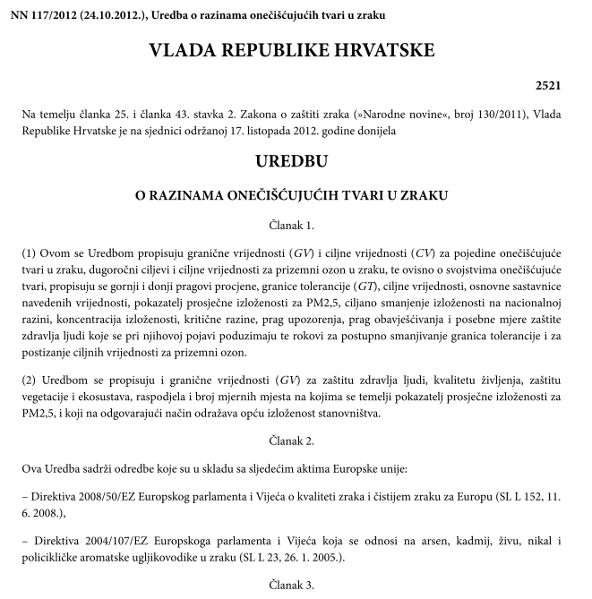
10.1 REGULATIONS OF THE REPUBLIC OF CROATIA
European Union IPA 2013 Programme for Croatia
Regulation on the level of pollutants in the air (Official Gazette 117/12)
It was adopted pursuant to Article 25 and Article 43, paragraph 2 of the Air Protection Act (Official Gazette 130/2011).
The regulation contains provision in line with EU directives:
Directive 2008/50/EZ,
Directive 2004/107/EZ and
(EU) Commission Directive 2015/1480 on amendment of certain annexes to Directives 2004/107/EZ i 2008/50/EZ
Institut za energetiku i zaštitu okoliša
Energy Research and Environmental Protection Institute

Slide 14
10.1 REGULATIONS OF THE REPUBLIC OF CROATIA
European Union IPA 2013 Programme for Croatia
Regulation on the level of pollutants in the air(Official Gazette 117/12)
The Regulation lays down limit values (LVs) and target values (TVs) for the protection of human health and the limit values (LVs) of quality of life for certain pollutants in the air,
Long-term goal and target value for ground-level ozone in the air,
Depending on the properties of the pollutant substance, it prescribes the upper and lower estimate thresholds,
Critical levels for the protection of vegetation and ecosystem
Warning threshold and alert threshold, as well as special human health protection measures taken at the time of their occurrence.
an average exposure indicator (PPI) for PM_{2,5} that adequately reflects the general exposure of population.
targeted reduction of exposure at the national level,
and the distribution and number of measuring points based on PPI for PM_{2,5}
Institut za energetiku i zaštitu okoliša
Energy Research and Environmental Protection Institute

Slide 15
10.1 REGULATIONS OF THE REPUBLIC OF CROATIA
European Union IPA 2013 Programme for Croatia
The stipulated values of the Regulation apply to the following pollutants:
- Sulfur dioxide (SO2),
- nitrogen oxides (NOx),
- Nitrogen dioxide (NO2),
- carbon monoxide (CO),
- fractions of fluidized particles by size of PM10 and PM2,5,
- lead (Pb), cadmium (Cd), arsenic (As), nickel (Ni) and benzo (a) pyrene in PM10,
- total gas mercury (Hg),
- benzene,
– hydrogen sulphide (H2S),
- Ammonia (NH3),
- methanal (formaldehyde),
- mercaptan,
- total sediment (TS),
- Content of lead, cadmium, arsenic, nickel, mercury, thallium and benzo (a) pyrene in TS
- ground-level ozone
Institut za energetiku i zaštitu okoliša
Energy Research and Environmental Protection Institute

Slide 16
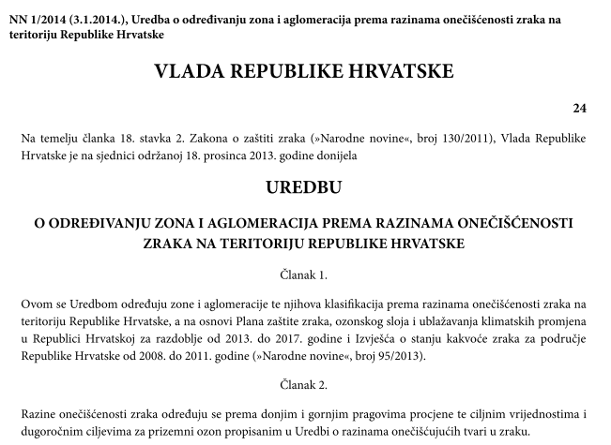
10.1 REGULATIONS OF THE REPUBLIC OF CROATIA
European Union IPA 2013 Programme for Croatia
Regulation on the Determination of Areas and Agglomerations by Levels of Air Pollution on the Territory of the Republic of Croatia (OG 1/14)
It was passed on basis of Article 18. paragraph 2. of the Air Protection Act(»Official Gazette«, no. 130/2011).
The regulation transposes EU Directives into the legal order of the Republic of Croatia:
Directive 2008/50/EC,
Directive 2004/107/EC
Institut za energetiku i zaštitu okoliša
Energy Research and Environmental Protection Institute

Slide 17
10.1 REGULATIONS OF THE REPUBLIC OF CROATIA
European Union IPA 2013 Programme for Croatia
Regulation on the Determination of Areas and Agglomerations by Levels of Air Pollution on the Territory of the Republic of Croatia
(OG 1/14)
The Regulation specifies zones and agglomerations and their classification according to the level of air pollution on the territory of the Republic of Croatia and on the basis of the Air Protection Plan, Ozone Layer and Climate Change Mitigation in the Republic of Croatia for the period 2013 to 2017 and the Air Quality Report for the Area Of the Republic of Croatia from 2008 to 2011 (Official Gazette 95/2013).
Air pollution levels are determined according to the lower and upper assessment thresholds and the long-term ground-level ozone targets set out in the Regulation on levels of pollutants in the air.
Institut za energetiku i zaštitu okoliša
Energy Research and Environmental Protection Institute

Slide 18
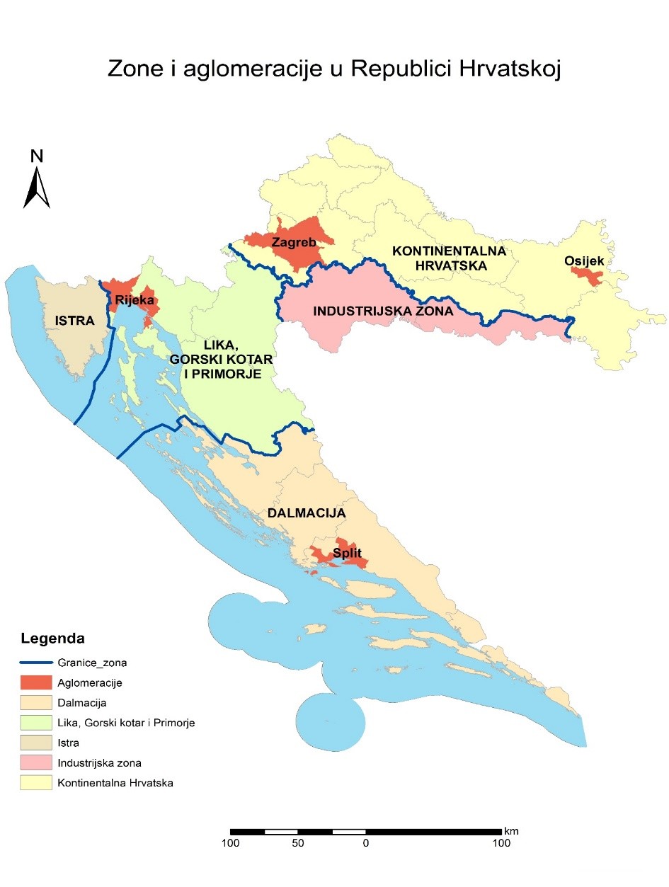
10.1 REGULATIONS OF THE REPUBLIC OF CROATIA
European Union IPA 2013 Programme for Croatia
Regulation (OG11/14) determined following for the purpose of air quality monitoring:
-five zones and four agglomerations
and:
-air pollution levels according to the lower and upper thresholds of assessment with respect to the protection of human health
-air pollution levels according to the lower and upper assessment thresholds and the long-term goal for ground-level ozone with respect to the protection of vegetation
Institut za energetiku i zaštitu okoliša
Energy Research and Environmental Protection Institute

Slide 19
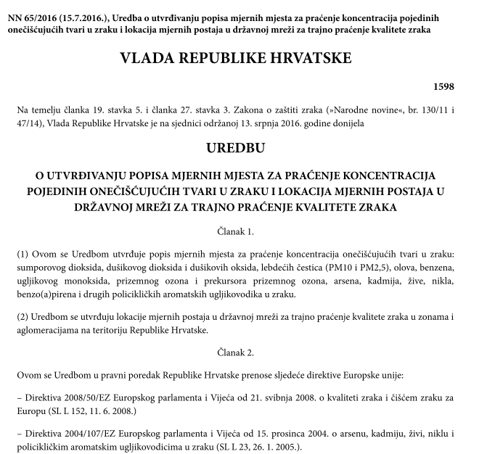
10.1 REGULATIONS OF THE REPUBLIC OF CROATIA
European Union IPA 2013 Programme for Croatia
Regulation on the establishment of a list of measurement points for concentration monitoring of certain pollutants in the air and the location of monitoring stations in the national network for the continuous air quality monitoring (OG 65/16)
It was passed on basis of Article 19 paragraph 5. and Article 27 paragraph 3 of Air Protection Act (»Official Gazette«, no. 130/11 and 47/14).
The regulation transposes EU Directives into the legal order of the Republic of Croatia :
Directive 2008/50/EC,
Directive 2004/107/EC
Institut za energetiku i zaštitu okoliša
Energy Research and Environmental Protection Institute

Slide 20
10.1 REGULATIONS OF THE REPUBLIC OF CROATIA
European Union IPA 2013 Programme for Croatia
Regulation on the establishment of a list of measurement points for concentration monitoring of certain pollutants in the air and the location of monitoring stations in the national network for the continuous air quality monitoring (OG 65/16)
The Regulation establishes a list of sites for the monitoring concentrations of pollutants in the air: sulfur dioxide, nitrogen dioxide and nitrogen oxides, fluidized matters (PM₁₀ and PM_{2,5}), lead, benzene, carbon monoxide, ground ozone and precursors of ground-level ozone, mercury, nickel, benzo (a) pyrene and other polycyclic aromatic hydrocarbons in the air.
The Regulation establishes the locations of monitoring stations in the national network for continuous monitoring of air quality in zones and agglomerations on the territory of the Republic of Croatia.
Institut za energetiku i zaštitu okoliša
Energy Research and Environmental Protection Institute

Slide 21
10.1 REGULATIONS OF THE REPUBLIC OF CROATIA
European Union IPA 2013 Programme for Croatia
List of measuring points for monitoring concentrations of air pollutants -
these metering points are an integral part of the air protection information system and are used for the purposes of the annual report on air quality and for the mutual exchange of information and reporting on air quality between the Croatian Environment and Nature Agency and the European Commission
Institut za energetiku i zaštitu okoliša
Energy Research and Environmental Protection Institute

Slide 22
10.1 REGULATIONS OF THE REPUBLIC OF CROATIA
European Union IPA 2013 Programme for Croatia
Monitoring Program for Air Pollution in the national network for permanent air quality monitoring (Official Gazette 73/16)
It was adopted pursuant to Article 29, paragraph 2 of the Air Protection Act (Official Gazette 130/2011, 47/2014).
Monitoring program for Air Pollution (air quality) in monitoring stations of national network for continuous air quality monitoring as set out in Article 5 of the Regulation on the establishment of a list of measuring points for monitoring concentrations of certain air pollutants and locations of monitoring stations in the national network for continuous air quality monitoring (Official Gazette 65/16) (hereinafter: the Regulation) contains:
Program A | AIR QUALITY MEASURING IN STATIONS ESTABLISHED IN AGGLOMERATIONS
Program B | AIR QUALITY MEASURING IN STATIONS ESTABLISHED IN THE ZONES
Institut za energetiku i zaštitu okoliša
Energy Research and Environmental Protection Institute

Slide 23
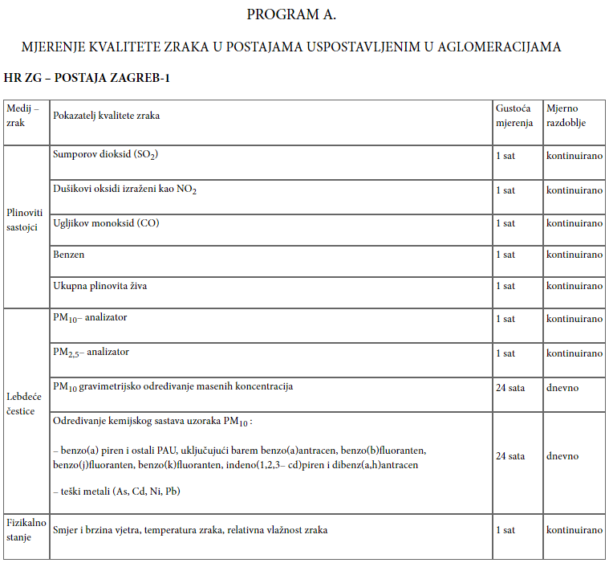
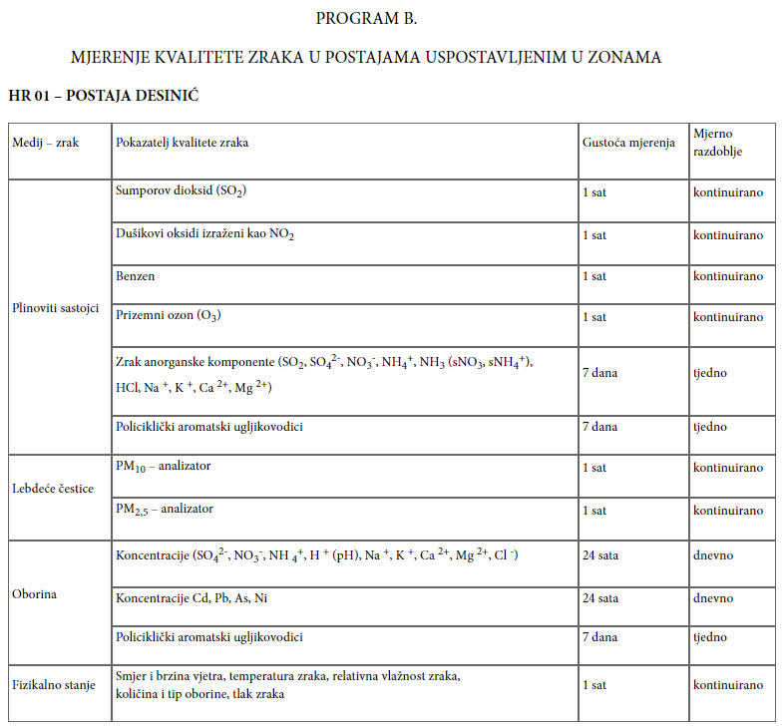
10.1 REGULATIONS OF THE REPUBLIC OF CROATIA
European Union IPA 2013 Programme for Croatia
Examples – Monitoring program at monitoring stations Zagreb-1 (A) and Desinić (B)
Institut za energetiku i zaštitu okoliša
Energy Research and Environmental Protection Institute

Slide 24
10.2 REGULATIONS OF THE REPUBLIC OF CROATIA
European Union IPA 2013 Programme for Croatia
The European air quality area is governed by three Directives and one Implementing Decision:
Directive 2008/50 / EC of the European Parliament and of the Council of 21 May 2008 on air quality and cleaner air for Europe o
Directive 2004/107 / EC of the European Parliament and of the Council of 15 December 2004 on arsenic, cadmium, mercury, nickel and polycyclic aromatic hydrocarbons in the air
Commission’s Directive (EU) 2015/1480 of 28 August 2015 amending certain Annexes to Directives 2004/107 / EC and 2008/50 / EC of the European Parliament and of the Council on the establishment of rules for reference methods, dana validation and location of sampling points for air quality assessment
Commission’s Implementing Decision 2011/850 / EU of 12 December 2011 laying down rules for Directives 2004/107 / EC and 2008/50 / EC of the European Parliament and of the Council on the mutual exchange of information and reporting on air quality
Institut za energetiku i zaštitu okoliša
Energy Research and Environmental Protection Institute

Slide 25
10.2 EU REGULATIONS
European Union IPA 2013 Programme for Croatia
Directives and Implementing Decision can be found at following links:
Directive 2008/50/EC
http://eur-lex.europa.eu/legal-content/EN/ALL/?uri=celex:32008L0050
Direktiva 2008/50/EZ PDF HR
Directive 2004/107/EC
http://eur-lex.europa.eu/legal-content/EN/TXT/?uri=CELEX%3A32004L0107
Direktiva 2004/107/EZ PDF HR
Commission’s Directive (EU) 2015/1480
http://eur-lex.europa.eu/legal-content/en/TXT/?uri=CELEX:32015L1480
Direktiva 2015/1480 PDF HR
Commission’s Implementation Decision 2011/850/EU
http://eur-lex.europa.eu/legal-content/EN/ALL/?uri=CELEX:32011D0850
Odluka 2011/850 PDF HR
Institut za energetiku i zaštitu okoliša
Energy Research and Environmental Protection Institute

Slide 26
10.2 EU REGULATIONS
European Union IPA 2013 Programme for Croatia
Directive 2008/50/EC– CAFE (Clean Air For Europe) stipulates measure related to:
1. definiranje i utvrđivanje ciljeva kvalitete zraka kako bi se izbjegli, spriječili ili umanjili štetni učinci na ljudsko zdravlje i okoliš u cjelini;
2. procjena kvalitete zraka u državama članicama na temelju zajedničkih metoda i kriterija;
3. dobivanje informacija o kvaliteti zraka kako bi se pomoglo u suzbijanju onečišćenja zraka i štetnih utjecaja, te radi nadzora dugoročnih trendova i poboljšanja koji su rezultat nacionalnih mjera i mjera Zajednice;
4. omogućavanje da informacije o kvaliteti zraka budu dostupne javnosti;
5. održavanje kvalitete zraka ako je dobra i poboljšavanje u ostalim slučajevima;
6. povećanje suradnje između država članica u smanjenju onečišćenja zraka.
Institut za energetiku i zaštitu okoliša
Energy Research and Environmental Protection Institute

Slide 27
10.2 EU REGULATIONS
European Union IPA 2013 Programme for Croatia
CAFE Direktiva also stipulates that Member States at appropriate levels determine competent authorities responsible for:
(a) air quality assessment;
(b) approval of measurement systems (methods, equipment, networks and laboratories);
(c) ensuring accuracy of measurements;
(d) analysis of the assessment method;
(e) Harmonization of the quality assurance programs in their territory if they are organized by the Commission for the entire Community;
(f) cooperation with other Member States and the Commission.
For the purposes of assessing and managing air quality, Member States shall establish zones and agglomerations throughout their national territory.
Institut za energetiku i zaštitu okoliša
Energy Research and Environmental Protection Institute

Slide 28
10.2 EU REGULATIONS
European Union IPA 2013 Programme for Croatia
CAFE Directive 2008/50/EC consists of 6 chapters and 16 annexes:
Chapters of CAFE Directive:
GENERAL PROVISIONS
AIR QUALITY ASSESSMENT
AIR QUALITY MANAGEMENT
PLANS
INFORMING AND REPORTING
COMMITTEE, TRANSITIONAL AND FINAL PROVISIONS
Institut za energetiku i zaštitu okoliša
Energy Research and Environmental Protection Institute

Slide 29
10.2 EU REGULATIONS
European Union IPA 2013 Programme for Croatia
Annexes to CAFE Directive:
GOALS FOR DATA QUALITY
Defining requirements for concentration assessment of SO₂, NO₂ and NO_{X}, particulate matter (PM₁₀ and PM_{2,5}), Pb, benzene and CO in air within a zone or agglomeration (lower and upper thresholds of assessment)
Air quality assessment and sampling points location for measuring SO₂, NO₂ and NO_{X}, particulate matter(PM₁₀ and PM_{2,5}), Pb, benzene and CO in air
MEASUREMENTS IN RURAL BACKGROUND LOCATIONS, REGARDLESS OF CONCENTRATION
Criteria for determining the smallest number of sampling points for measurements at permanent conceNtration site of SO₂, NO₂ i NO_{X}, particulate matter (PM₁₀ and PM_{2,5}), Pb, benzene and CO in air
Reference methods for assessing concentrations of SO₂, NO₂ and NO_{X}, particulate matters (PM₁₀ and PM_{2,5}), Pb, benzene and CO and ground-level ozone
Institut za energetiku i zaštitu okoliša
Energy Research and Environmental Protection Institute

Slide 30
10.2 EU REGULATIONS
European Union IPA 2013 Programme for Croatia
TARGET VALUES AND LONG-TERM GOALS FOR GROUND-LEVEL OZONE
Criteria for classification and setting up sampling points for assessing ground-level concentrations
Criteria for determining the smallest numbers of sampling points for measuring ground-level ozone concentrations at permanent measurement point
MEASURING GROUND-LEVEL OZONE PRECURSORS
THRESHOLD VALUES FOR HUMAN HEALTH PROTECTION
WARNING AND PRECAUTIONS THRESHOLDS
CRITICAL LEVELS FOR VEGETATION PROTECTION
TARGET REDUCTION OF EXPOSURE AT NATIONAL LEVEL, TARGET VALUE AND THRESHOLD VALUE FOR PM_{2,5}
Information to be included in local, regional or national plans to improve air quality
INFORMING THE PUBLIC
Institut za energetiku i zaštitu okoliša
Energy Research and Environmental Protection Institute

Slide 31
10.2 EU REGULATIONS
European Union IPA 2013 Programme for Croatia
Directive 2004/107/EC (Article 1)
establishes target values for concentrations of arsenic, cadmium, nickel and benzo (a) pyrene in the air in order to avoid, prevent or reduce the harmful effects of arsenic, cadmium, nickel and polycyclic aromatic hydrocarbons on human health and the environment as a whole;
prescribes the maintenance of air quality when it is good, with respect to arsenic, cadmium, nickel and polycyclic aromatic hydrocarbons, and improvement in other cases;
determines common methods and criteria for assessing the concentration of arsenic, cadmium, mercury, nickel and polycyclic aromatic hydrocarbons in the air as well as for the deposition of arsenic, cadmium, mercury, nickel and polycyclic aromatic hydrocarbons;
prescribes the collection of appropriate data on the concentrations of arsenic, cadmium, mercury, nickel and polycyclic aromatic hydrocarbons in the air as well as about deposition of arsenic, cadmium, mercury, nickel and polycyclic aromatic hydrocarbons and ensures their availability to the public.
Institut za energetiku i zaštitu okoliša
Energy Research and Environmental Protection Institute

Slide 32
10.2 EU REGULATIONS
European Union IPA 2013 Programme for Croatia
Directive 2004/107/EC : prescribes (Articles 3) that Member States:
1. take all necessary measures that do not require disproportionate costs to ensure that as of 31 December 2012 the concentrations of arsenic, cadmium, nickel and benzo (a) pyrene, which are used as an indicator of the carcinogenic risk of polycyclic aromatic hydrocarbons in the air, do not exceed the target values
2. compile a list of zones and agglomerations in which the levels of arsenic, cadmium, nickel and benzo (a) pyrene are lower than the corresponding target values ​​and maintain the levels of these pollutants in those zones and agglomerations below the respective target values ​​and try to preserve the highest air quality compatible with sustainable development.
3. compile a list of zones and agglomerations in which the target values ​​have been exceeded. For such zones and agglomerations, Member States state areas where those values ​​are exceeded, as well as sources contributing to it.
In those areas the Member States concerned shall take all necessary measures that do not require disproportionate costs and which are directed specifically towards the main sources of emissions in order to attain the target values.
Institut za energetiku i zaštitu okoliša
Energy Research and Environmental Protection Institute

Slide 33
10.2 EU REGULATIONS
European Union IPA 2013 Programme for Croatia
Directive of the Commission (EU) 2015/1480
defines the reference methods of air quality measurement for the purpose of assessing the level of pollution by introducing the latest edition of standards
clarifies the manner of recognition of type approvals proving that the equipment meets the requirements of the reference methods issued in other Member States
aligns the quality data goals with requirements of standards
clarifies the role and tasks of National Reference Laboratories in order to ensure the quality of air quality assessment – data validation
removes ambiguities regarding the criteria for selecting locations of measurement points and documentation of measurement points
introduces requirements for the assessment of ground-level ozone that take into account national conditions.
Institut za energetiku i zaštitu okoliša
Energy Research and Environmental Protection Institute

Slide 34
10.2 EU REGULATIONS
European Union IPA 2013 Programme for Croatia
Implementing Decision of the Commission 2011/850/EU
passed on basis of CAFE Directive 2008/50/EC that in Article 28 prescribes implementing measures for information transmission and reporting from Article 27.
Article 27 prescribes the transfer of information and reporting:
Member States shall ensure that air quality information is available to the Commission within the prescribed time, as specified in the implementing measures referred to in Article 28
Article 28 prescribes implementing measures:
The Commission shall determine which additional information should be provided by the Member States and the deadlines for such information to be provided.
The Commission also finds ways to streamline data supply and mutual exchange of information and data from networks and individual monitoring stations for the measurement of air pollution within Member States.
The implementing decision came into force on 1 January 2014. - The decision was discussed in more detail in section 14.2. Implementing Decision EC 2011/850 / EU (IPR)
Institut za energetiku i zaštitu okoliša
Energy Research and Environmental Protection Institute

Slide 35
10.3 EXAMPLE OF EU REGULATIONS IMPLEMENTATION IN THE UK
European Union IPA 2013 Programme for Croatia
The Environment Agency manages UK national measurement locations ion behalf of Defra (British Ministry of Environmental Protection, Food and Rural Areas) and Devolved Administrations (institutions operating only within a certain part of the United Kingdom – executive institutions are created for Scotland, Northern Ireland and Wales).
The Environment Agency currently manages a total of about 300 air quality monitoring stations across the United Kingdom, which are organized into measuring networks according to what type of information they collect using a particular method. What pollutant substances are measured and which methods are used depends on the reason why the network is established and the purpose for which the data will be used.
There are two main types of measuring networks in the UK - automatic and non-automatic networks.
Institut za energetiku i zaštitu okoliša
Energy Research and Environmental Protection Institute

Slide 36
10.3 EXAMPLE OF EU REGULATIONS IMPLEMENTATION IN THE UK
European Union IPA 2013 Programme for Croatia
Automatic urban and rural network (AURN)
Parameters Measured | Monitoring sites and data
Ambient Temperature Barometric pressure Carbon monoxide Daily measured PM₁₀ (uncorrected) Daily measured PM_{2.5} (uncorrected) Modelled Temperature Modelled Wind Direction Modelled Wind Speed Nitric oxide Nitrogen dioxide Nitrogen oxides as nitrogen dioxide Non-volatile PM₁₀ (Hourly measured) Non-volatile PM_{2.5} (Hourly measured) Ozone PM10 Ambient pressure measured PM10 Ambient Temperature PM2.5 Ambient Preasure PM2.5 Ambient Temperature PM₁₀ particulate matter (Daily measured) PM₁₀ particulate matter (Hourly measured) PM₁ particulate matter (Hourly measured) PM_{2.5} particulate matter (Daily measured) PM_{2.5} particulate matter (Hourly measured) Rainfall Relative Humidity Sulphur dioxide Total Particulates Volatile PM₁₀ (Hourly measured) Volatile PM_{2.5} (Hourly measured) Wind Direction Wind Speed | Current sites: 142 Total sites: 218 Data availability: 22/02/1973 to 18/12/2017
AURN is the UK's largest automatic air quality monitoring network and is the main network used to report on compliance with the Ambient Air Quality Directives.
Institut za energetiku i zaštitu okoliša
Energy Research and Environmental Protection Institute

Slide 37
10.3 EXAMPLE OF EU REGULATIONS IMPLEMENTATION IN THE UK
European Union IPA 2013 Programme for Croatia
Automatic urban and rural network (AURN)
Numerous organizations are involved in the day-to-day business of the network.
Currently is the role of AURN Central Management and Coordination Unit contracted with Bureau Veritas and Ricardo Energy & Environment assumes the role of Quality Assurance and Quality Control (QA / QC) for the entire AURN.
Responsibility for the operation of individual measuring points is assigned to local organizations, such as the local environmental authority with appropriate field experience.
Network calibration gases are supplied by Air Liquide Ltd and they obtain the UKAS calibration certificate from Ricardo Energy & Environment.
Institut za energetiku i zaštitu okoliša
Energy Research and Environmental Protection Institute

Slide 38
10.3 EXAMPLE OF EU REGULATIONS IMPLEMENTATION IN THE UK
European Union IPA 2013 Programme for Croatia
Automatic urban and rural network (AURN)
The main goals of the network are:
- Verification of the status of air quality standards and objectives (in accordance with the Directives);
- Informing the public about air quality;
- Provide air quality information to the local administration for review and assessment under the Air Quality Strategy in the United Kingdom;
-Determination of long-term trends in air pollution concentrations; and
-Assessing the effectiveness of policies to control pollution.
Institut za energetiku i zaštitu okoliša
Energy Research and Environmental Protection Institute

Slide 39
10.3 EXAMPLE OF EU REGULATIONS IMPLEMENTATION IN THE UK
European Union IPA 2013 Programme for Croatia
Automatic urban and rural network (AURN)
Data from AURN are used for:
Reporting to the European Commission according to the Air Quality Directives
Comparison with air quality goals as stated in the Air Quality Strategy
Informing the public through air quality newsletters
Forecasts of future levels of air quality
Development of a policy for protection of human health and ecosystems
For EMEP (European Monitoring & Evluation Program)
National indicators of environmental quality
Institut za energetiku i zaštitu okoliša
Energy Research and Environmental Protection Institute

Slide 40
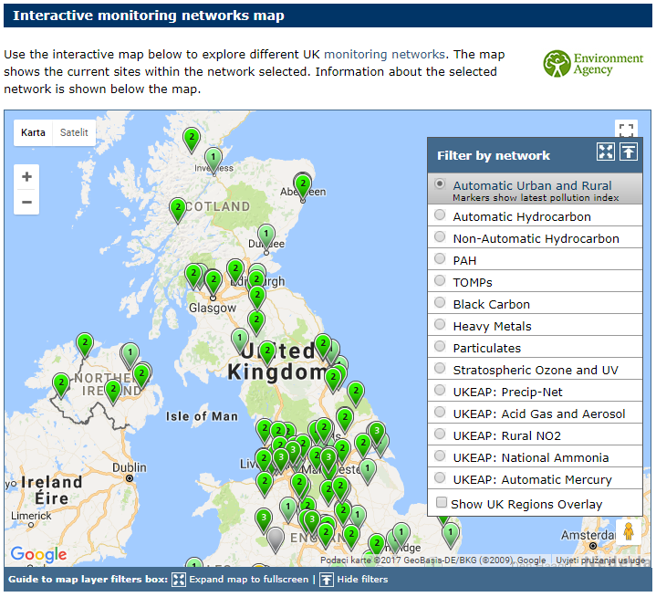
10.3 EXAMPLE OF EU REGULATIONS IMPLEMENTATION IN THE UK
European Union IPA 2013 Programme for Croatia
Automatic urban and rural network (AURN)
Interactive page provides an interactive overview of the AURN network with links to site information and the latest data (current concentrations) on the link:
https://uk-air.defra.gov.uk/interactive-map
Institut za energetiku i zaštitu okoliša
Energy Research and Environmental Protection Institute

Slide 41
10.3 EXAMPLE OF EU REGULATIONS IMPLEMENTATION IN THE UK
European Union IPA 2013 Programme for Croatia
Automatic urban and rural network (AURN)
Monitoring methods within AURN are described on the link:
https://uk-air.defra.gov.uk/networks/monitoring-methods?view=eu-standards
Data verification and validation
are described in the Data Validation Process and the Ratification Process (PDF) document that contains more information on the process of data validation and ratification on the link:
https://uk-air.defra.gov.uk/assets/documents/Data_Validation_and_Ratification_Process_Apr_2017.pdf
Institut za energetiku i zaštitu okoliša
Energy Research and Environmental Protection Institute

Slide 42
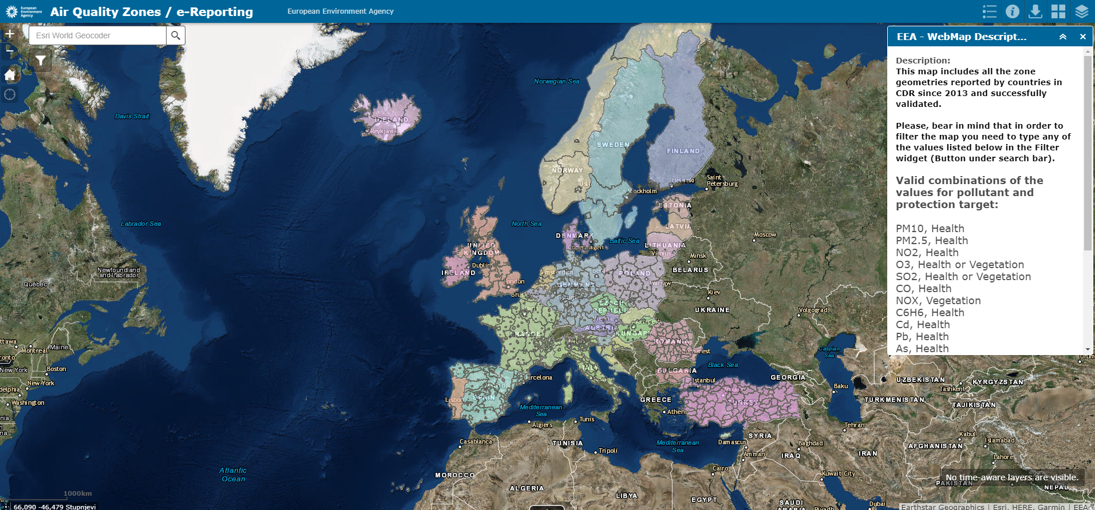
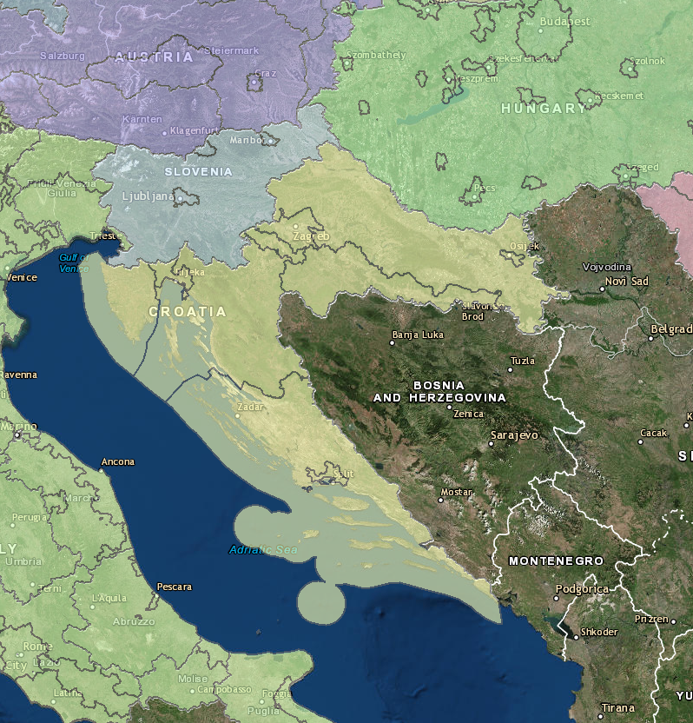
10.4 EXAMPLES OF STATE NETWORK ORGANIZATION IN OTHER EU COUNTRIES
European Union IPA 2013 Programme for Croatia
Air quality monitoring zones in Europe - All air quality monitoring zones in the EU can be found on the link: http://maps.eea.europa.eu/wab/AirQualityZones/
Institut za energetiku i zaštitu okoliša
Energy Research and Environmental Protection Institute

Slide 43
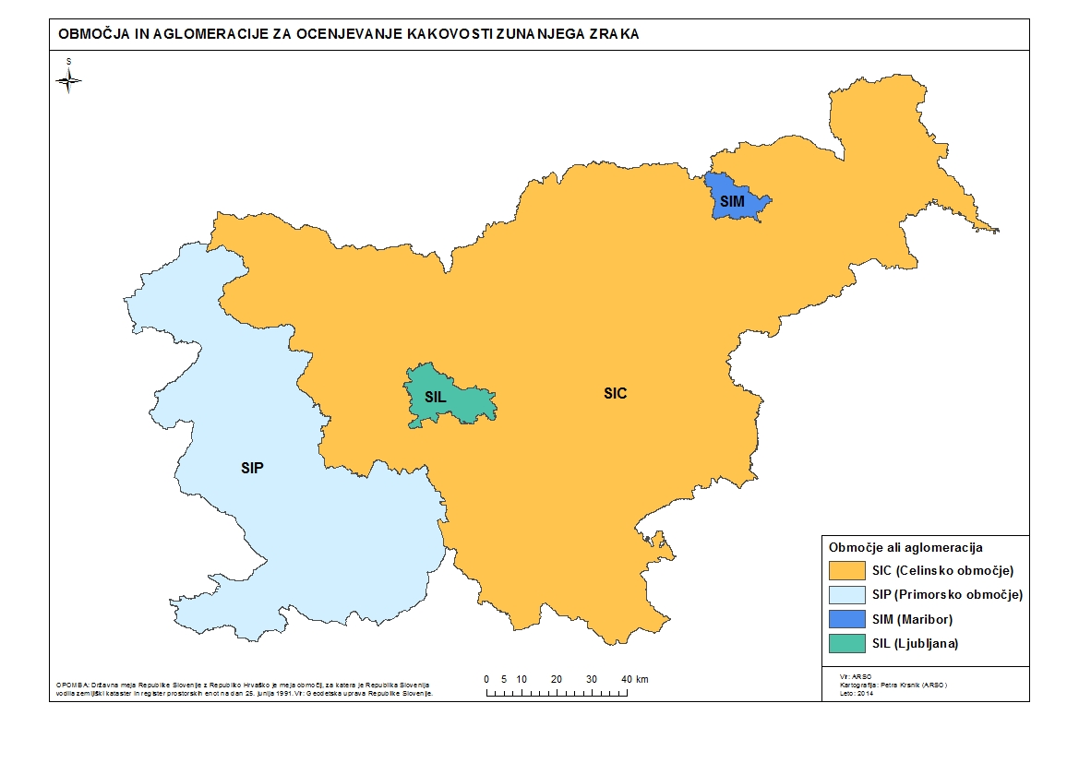
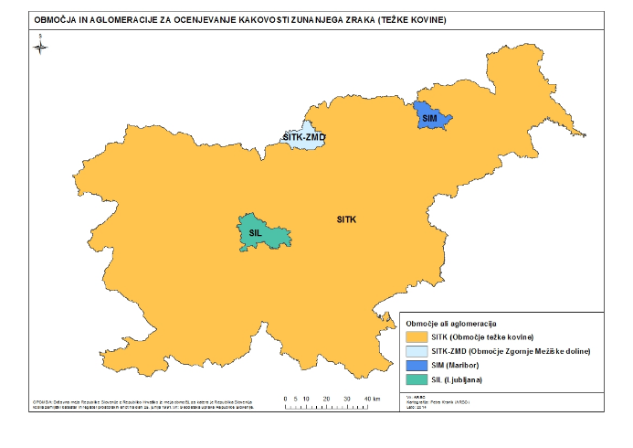
10.4 EXAMPLES OF STATE NETWORK ORGANIZATION IN OTHER EU COUNTRIES
European Union IPA 2013 Programme for Croatia
Slovenia
(SO₂, NO₂, NO_{x}, O₃, PM₁₀, PM_{2,5}, C₆H₆, benzo(a)piren)
(Pb, Ni, As, Cd)
Institut za energetiku i zaštitu okoliša
Energy Research and Environmental Protection Institute

Slide 44
10.4 EXAMPLES OF STATE NETWORK ORGANIZATION IN OTHER EU COUNTRIES
European Union IPA 2013 Programme for Croatia
Slovenia
National Air Quality Monitoring Network:
-18 monitoring stations
-Measured parameters: PM10 and PM2,5, NOx, SO2, CO, VOC, heavy metals and PAHs in PM10, ions and OC / EC in PM2.5, Hg in the air, meteorological conditions
National Network for Precipitation Quality Monitoring:
-5 monitoring stations
-Measured parameters: pH, conductivity, ions, heavy metals, PAH
Additional air quality monitoring network:
-Around thermal power plants and the cement industry
-Additional monitoring sites in major cities (Ljubljana, Maribor, Celje)
Institut za energetiku i zaštitu okoliša
Energy Research and Environmental Protection Institute

Slide 45
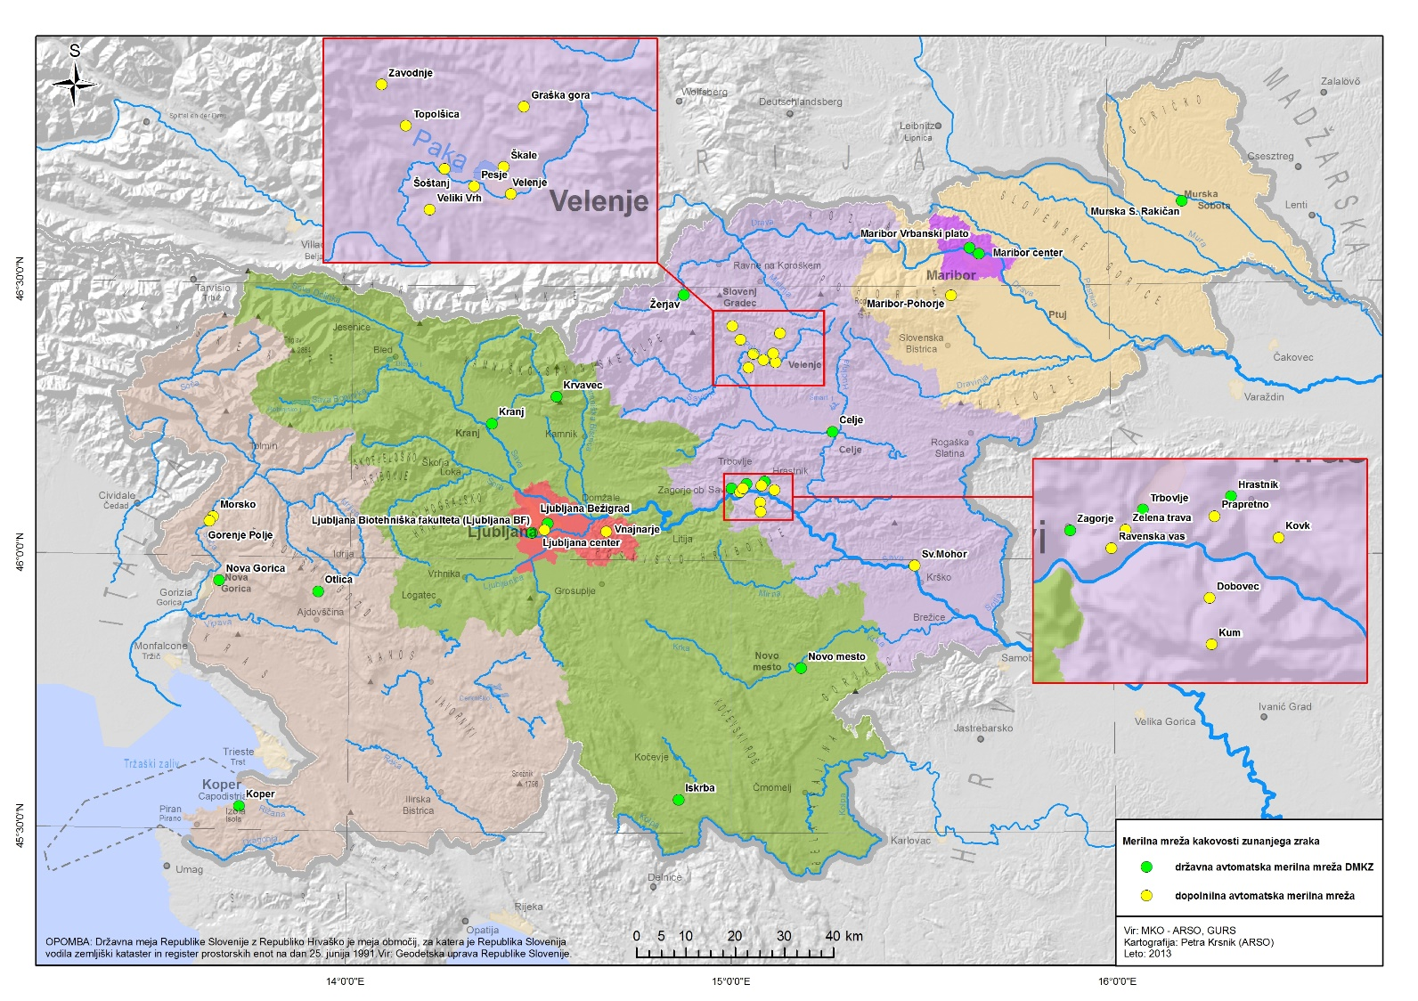
10.4 EXAMPLES OF STATE NETWORK ORGANIZATION IN OTHER EU COUNTRIES
European Union IPA 2013 Programme for Croatia
Slovenia – Air quality monitoring network
Institut za energetiku i zaštitu okoliša
Energy Research and Environmental Protection Institute

Slide 46
10.4 EXAMPLES OF STATE NETWORK ORGANIZATION IN OTHER EU COUNTRIES
European Union IPA 2013 Programme for Croatia
Slovenia
Quality Assurance / Quality Control:
-Measurements are performed using reference methods
-On-line measurements are controlled daily, monthly and annually
-The calibration of the instruments is carried out every three months at the measuring site and once a year in the calibration laboratory
-The calibration laboratory is accredited according to ISO / IEC 17025: 2005 ((O₃, NO, NO₂, SO₂, CO, meteorological parameters - T, RH, p)
-Chemical analytical laboratory is accredited according to ISO / IEC 17025: 2005
-PM₁₀, PM_{2,5}
-Pb, Cd, As, Ni and Bezo (a) pyrene in u PM₁₀
-pH, conductivity, Cr, Ni, Cu, Zn, Cd, Pb, As, cations, anions in rain
Institut za energetiku i zaštitu okoliša
Energy Research and Environmental Protection Institute

Slide 47
10.4 EXAMPLES OF STATE NETWORK ORGANIZATION IN OTHER EU COUNTRIES
European Union IPA 2013 Programme for Croatia
Slovenia
The main challenges related to air quality:
-Increased concentrations of PM₁₀ with frequent exceedances of daily limit value in the cold part of the year
-High ozone concentrations in summer months (especially in the zone of Primorje)
Action Plans for Improving Air Quality:
-In response to the exceedance of the daily limit value PM10, action plans for improving the air quality for 6 municipalities (Ljubljana, Maribor, Celje, Novo mesto, Murska Sobota, Kranj) and one region (Zasavje) were made.
-The plans mainly focus on reducing emissions due to heating and traffic
Institut za energetiku i zaštitu okoliša
Energy Research and Environmental Protection Institute

Slide 48
10.4 EXAMPLES OF STATE NETWORK ORGANIZATION IN OTHER EU COUNTRIES
European Union IPA 2013 Programme for Croatia
Poland – air quality monitoring system
46 zones and agglomerations in 2010:
- 12 agglomerations (over 250.000 inhabitants)
- 18 cities with over 100.000 inhabitants
- 16 zones – the rest are provinces
Within the State Environmental Monitoring Program
measurements:
- 16 networks (managed byVIEP)
- 260 stations with manual automatic or automatic measurements
- 650 analyzers (automatic measurement); ~ 520 atVIEPstation
- 184 PM10 / PM2.5 samplers, 178 at VIEP stations
Modelling:
- At national ozone level + regionally in several countries
Institut za energetiku i zaštitu okoliša
Energy Research and Environmental Protection Institute

Slide 49
10.4 EXAMPLES OF STATE NETWORK ORGANIZATION IN OTHER EU COUNTRIES
European Union IPA 2013 Programme for Croatia
Poland – air quality monitoring system – roles and responsibilities
Central inspectorate for environment protection (CIEP):
• coordination of monitoring and assessment of air quality in Poland within the framework of the State Environmental Monitoring Program
• national data collection and transfer to national and foreign institutions, including reporting to EEA and EC
• monitoring the AQ assessment system conducted by the Regional Environmental Inspectorates (VIEPs) (station / measurement configurations, modeling, objective evaluation) and estimates by:
acceptance of Regional Environmental Monitoring Programs;
station visits (calibration of measurement systems, station construction, etc.);
guidance, training, IT tools (including data collection and transmission systems), procurement of equipment.
Institut za energetiku i zaštitu okoliša
Energy Research and Environmental Protection Institute

Slide 50
10.4 EXAMPLES OF STATE NETWORK ORGANIZATION IN OTHER EU COUNTRIES
European Union IPA 2013 Programme for Croatia
Poland – air quality monitoring system – roles and responsibilities
16 Regional Environmental Inspectorates (VIEP) (Vojvotsva):
• Air quality monitoring and air quality assessment (regional level):
Ministry of Environmental Protection:
• Air quality policy, including coordination of action plans implementation and reporting on action plans
Regional (Vojvotstva) offices:
• drawing up action plans and short-term plans to improve air quality
Institut za energetiku i zaštitu okoliša
Energy Research and Environmental Protection Institute

Slide 51
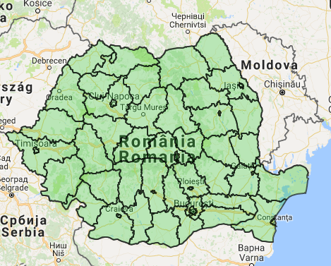
10.4 EXAMPLES OF STATE NETWORK ORGANIZATION IN OTHER EU COUNTRIES
European Union IPA 2013 Programme for Croatia
Romania – air quality monitoring system
13 agglomerations with a population of more than 250 000 inhabitants or with a population density of more than 3000 inhabitants per km2 (if less than 250 000 inhabitants)
41 zones for air quality assessment and control
The National Air Quality Monitoring Network was established in the period 2005-2007 and in the first phase had 117 air quality monitoring stations and currently includes:
142 air quality monitoring stations;
41 laboratories for analysis with the necessary equipment,
42 databases for data processing (1 center at the level of each zone and 1 national data center).
Institut za energetiku i zaštitu okoliša
Energy Research and Environmental Protection Institute

Slide 52
10.4 EXAMPLES OF STATE NETWORK ORGANIZATION IN OTHER EU COUNTRIES
European Union IPA 2013 Programme for Croatia
Romania – air quality monitoring system
The locations of monitoring stations comply with the provisions of Directive 2008/50 / EC: there are 24 traffic stations, 57 industrial locations, 37 urban background metering points, 15 suburban background metering points, 6 regional background locations and 3 EMEP locations.
The air quality data have been obtained from all monitoring stations and are sent to local centers and also to public panels. At the national level there are 107 public information boards on air quality, namely:
48 outdoor panels located in highly populated areas in cities or pedestrian zones;
59 indoor panels in the buildings of public administration offices (city halls, environmental agencies, etc.).
Data on air quality on national level can also be accessed on following website:
www.calitateaer.ro
Institut za energetiku i zaštitu okoliša
Energy Research and Environmental Protection Institute

Slide 53
10.4 EXAMPLES OF STATE NETWORK ORGANIZATION IN OTHER EU COUNTRIES
European Union IPA 2013 Programme for Croatia
Romania – air quality monitoring system
Responsibilities of the Government toward the National Air Quality Monitoring Network:
Local environmental agencies - manage local air quality monitoring networks (at county level): measurement, data validation , local air quality assessment, reporting to the National Environmental Agency, public informing;
National Agency for Environmental Protection is responsible for:
database, data certification, air quality assessment at the national level, reports to the Ministry of Environmental Protection and Forests;
The Ministry of Environmental Protection and Forests reports to European and international institutions according to international obligations.
Institut za energetiku i zaštitu okoliša
Energy Research and Environmental Protection Institute

Slide 54
10.5 RMCEI - definitions
European Union IPA 2013 Programme for Croatia
Inspecting whom?
All those who have emissions to the environment (water, air, soil) and who need a licence for their work according to EU regulations - we call them "CONTROLLED INSTALLATIONS" - controlled installations
Institut za energetiku i zaštitu okoliša
Energy Research and Environmental Protection Institute

Slide 55
10.5 RMCEI - definitions
European Union IPA 2013 Programme for Croatia
Who can conduct an environmental inspection?
Each competent authority appointed by the EU Member State to be in charge of this area
The said public person may designate any legal entity (in accordance with the regulations of the Member State) to carry out these activities under their supervision, called "INSPECTING AUTHORITY" - Inspection bodies
Who is in charge of controlled installation?
Anyone who manages or economically controls the controlled installation controlled installation operator.
Institut za energetiku i zaštitu okoliša
Energy Research and Environmental Protection Institute

Slide 56
10.5 RMCEI - planning
European Union IPA 2013 Programme for Croatia
Organizing Environmental Inspection
Each Member State shall ensure that an environmental inspection provides a high level of environmental protection and that the supervision of controlled facilities is organized and conducted in a planned way and according to the same criteria and that the monitoring reports contain relevant information in line with the recommendations.
Institut za energetiku i zaštitu okoliša
Energy Research and Environmental Protection Institute

Slide 57
10.5 RMCEI - planning
European Union IPA 2013 Programme for Croatia
Plans for Environmental Inspection
Each Member State shall ensure that the environmental inspection is planned in advance and that such plans cover the supervision of controlled installations throughout the territory of the Member State and that all inspection bodies carry out supervision in the same way.
What should plans be based on?
EU regulations to be applied
the register of controlled installations and their level of compliance with EU environmental standards
assessment of major environmental threats
data on previous controls
Institut za energetiku i zaštitu okoliša
Energy Research and Environmental Protection Institute

Slide 58
10.5 RMCEI - planning
European Union IPA 2013 Programme for Croatia
The environmental inspection plan should contained at least
geographic area it covers
the time it covers
include special audit requirements
identify the location or types of controlled installations, including the frequency of monitoring by type or location
routine monitoring programs with regard to the form of environmental threat
to provide framework procedures for unplanned controls in the case of complaints of citizens, accidents, cases of non-compliance or issuance of permits
to ensure coordination between various inspection bodies if they exist
Institut za energetiku i zaštitu okoliša
Energy Research and Environmental Protection Institute

Slide 59
10.5 RMCEI monitoring
European Union IPA 2013 Programme for Croatia
Site monitoring
Each Member State should ensure that the following criteria are always applied in all inspections
to always check the EU regulations relevant to the given monitoring
If more inspectors conduct inspection, they share all relevant information both from the field and other types of information
that reports are made about the findings of inspection on the basis of the criteria described in the RMCEI and that they are available to all competent authorities in the Member State
that inspectors have a legal basis to provide access to the supervised operator and to all relevant information
due to lack of conformity / irregularities
Institut za energetiku i zaštitu okoliša
Energy Research and Environmental Protection Institute

Slide 60
10.5 RMCEI - monitoring
European Union IPA 2013 Programme for Croatia
What types of inspection are there?
Routine - Scheduled
Unplanned
-due to charges
-due to accidents
-due to lack of conformity / irregularities
Institut za energetiku i zaštitu okoliša
Energy Research and Environmental Protection Institute

Slide 61
10.5 RMCEI - monitoring
European Union IPA 2013 Programme for Croatia
Planned- routine site monitoring
Each Member State should ensure that inspections of controlled plants are regularly carried out as part of routine environmental monitoring and that the following criteria are always applied
during routine monitoring, to re-examine the entire impact of the supervised facility on the environment in the context of the relevant regulation, monitoring programs and in accordance with the organizational aspects of the inspection body
that such monitoring promotes and enhances the knowledge of operators in this area
to assess the effectiveness of the existing permit of the monitored plant in view of its environmental impact and to consider the need to change the permit in the sense of its improvement
Institut za energetiku i zaštitu okoliša
Energy Research and Environmental Protection Institute

Slide 62
10.5 RMCEI - monitoring
European Union IPA 2013 Programme for Croatia
Unplanned site monitoring
Each Member State should ensure that unplanned inspections are carried out in the following cases
in cases of serious environmental complaints and as soon as possible after receiving such complaints
in the case of serious accidents and incidents as well as serious inconsistencies with EU regulations, and as soon as possible after such information reaches the inspection body
prior to the commissioning of the monitored facility and after issuing a permit to that end to determine whether the activities of the operator comply with the measures and requirements of the permit
for the same reasons when changing the license to a monitored installation
Institut za energetiku i zaštitu okoliša
Energy Research and Environmental Protection Institute

Slide 63
10.5 RMCEI – reporting on monitoring
European Union IPA 2013 Programme for Croatia
Reports and conclusions after site monitoring
Each Member State should ensure that after each inspection on monitoring and the conclusions adopted on it, a report is compiled that will be uniquely labeled and recognizable.
The report should contain findings on compliance with the EU regulations of the monitored facility, assessment and conclusions on the need to undertake further actions (measures to address deficiencies, initiate infringement procedure or criminal proceedings, modify the permit).
It should also contain information on whether there is a need for subsequent inspection.
The report should be made as soon as possible after completing the monitoring.
Institut za energetiku i zaštitu okoliša
Energy Research and Environmental Protection Institute

Slide 64
10.5 RMCEI - reporting on monitoring
European Union IPA 2013 Programme for Croatia
Reports and conclusions after site monitoring
After each report has been written it should be kept in the available database.
The full report or, if this is not practical, conclusions of the report, should be provided to the operator of the monitored plant in accordance with Directive 90/313 / EEC.
The report should be available to the public for up to two months after monitoring.
Institut za energetiku i zaštitu okoliša
Energy Research and Environmental Protection Institute

Slide 65
10.5 RMCEI
European Union IPA 2013 Programme for Croatia
Investigations (monitoring) in the case of serious accidents, incidents and inconsistencies
Each Member State should ensure that investigations (monitoring) are carried out by the competent authority in the event of serious accidents, incidents and non-compliance with EU regulations in order to
determine the cause of the event and, if possible, responsibility for the event and to report to the competent authorities (the State Attorney's Office) if necessary
mitigate or if possible remove the impact of an event on the environment by defining measures to be taken by operators or competent bodies
to establish measures to prevent the event from developing further in the negative direction
to initiate an infringement or criminal procedure if necessary, as well as to ensure that the operator takes appropriate action
Institut za energetiku i zaštitu okoliša
Energy Research and Environmental Protection Institute

Slide 66
10.5 RMCEI – reporting to EC
European Union IPA 2013 Programme for Croatia
Reporting on Environmental Inspection Activities
Member States are given a two –year deadline from publication of Recommendations to submit their first report on all environmental inspections carried out by inspection bodies to the European Commission.
Such reports should be public and should contain the following information
about the staff and other resources of inspection bodies
details of the role and engagement of inspection bodies in drafting plans for environmental inspection
the details of the number of monitoring at sites for the parts of each type of supervised plants and the estimated time taken to supervise all plants of that type
Institut za energetiku i zaštitu okoliša
Energy Research and Environmental Protection Institute

Slide 67
10.5 RMCEI - reporting to EC
European Union IPA 2013 Programme for Croatia
Reporting on Environmental Inspection Activities
on the degree of compliance of monitored plants with EU environmental legislation
short description and number of activities (unplanned monitoring) due to serious complaints, incidents, accidents and non-compliance with EU regulations
evaluation of the success of the implementation of environmental inspection plans as well as recommendations for future plans
Institut za energetiku i zaštitu okoliša
Energy Research and Environmental Protection Institute

Slide 68
THANK YOU FOR YOUR ATTENTION
Energy Research and Environmental Protection Institute
Disclaimer: The contents of this publication are the sole responsibility of EKONERG – Energy Research and Environmental Protection Institute, Ltd. and can in no way be taken to reflect the views of the European Union
This project is funded by the European Union

